Slide 1

Simple Baselines for Image Restoration
Author :
Liangyu Chen, Xiaojie Chu, Xiangyu Zhang, Jian
MEGVII Technology
Advisor : Tsung-Jung Liu
Student : Chi-Mao Fan
Notes:
2022.1.9 arXiv

Slide 2

Outline
01
Introduction
02
Related Work
03
Method
04
Experiment
05
Conclusion

Slide 3
01
Introduction
02
Related Work
03
Method
04
Experiment
05
Conclusion

Slide 4
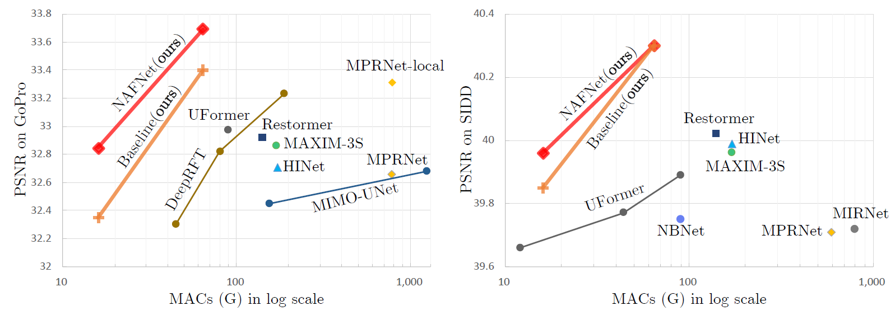
01
Introduction
(1/2)
Image restoration is the task of recovering a clean image from its degraded version. Some examples of degradation such as Image Denoising, Deblurring, etc.
4

Slide 5
01
Introduction
(2/2)
Contribution
Present a SOTA performances on several restoration tasks with lower system complexity.
Present a simplified channel attention (SCA) improved from Channel attention block.
Remove the nonlinear activation free network. To the best of their knowledge, it’s the first work demonstrate that non-linear activation functions may not be necessary for SOTA computer vision methods.
5

Slide 6
Outline
01
Introduction
02
Related Work
03
Method
04
Experiment
05
Conclusion

Slide 7
01
Introduction
02
Related Work
03
Method
04
Experiment
05
Conclusion

Slide 8
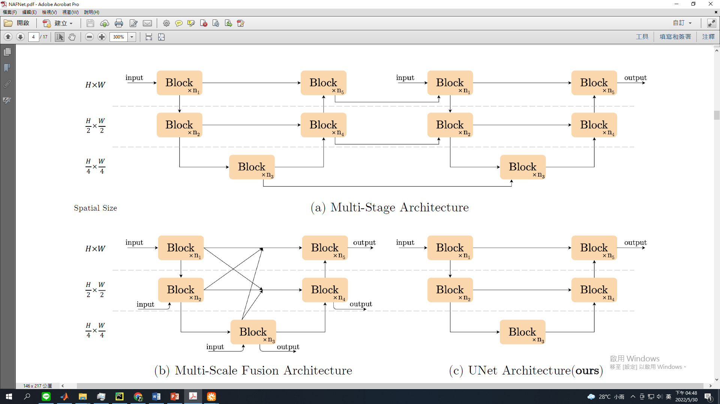
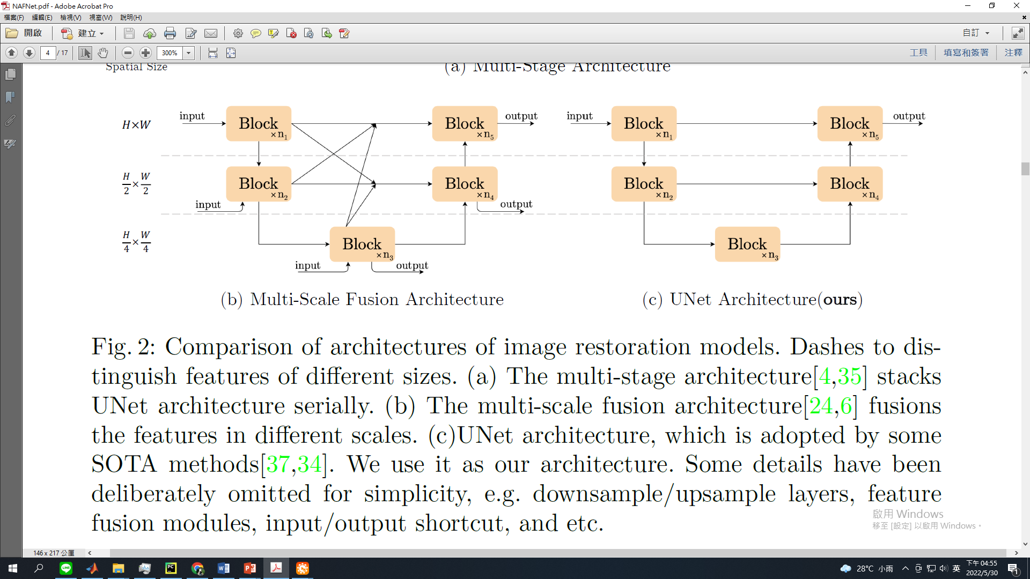
02
Related Work
(1/2)
Image restoration
Inter-block complexity
MPRNet (CVPR 2020 oral)
HINet (CVPR 2021)
MAXIM (CVPR 2022 oral)
Intra-block complexity
MIRNet (ECCV 2020)
SwinIR (ICCV 2021)
Restormer (CVPR 2022 oral)
8
Notes:
MPRNet
Swin Transformer, SwinIR

Slide 9
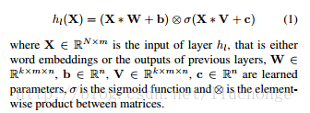
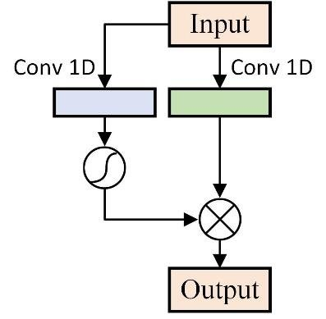
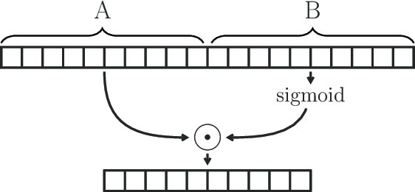
02
Related Work
(2/2)
Gated Linear Units (2017)
9

Slide 10
Outline
01
Introduction
02
Related Work
03
Method
04
Experiment
05
Conclusion

Slide 11
01
Introduction
02
Related Work
03
Method
04
Experiment
05
Conclusion

Slide 12
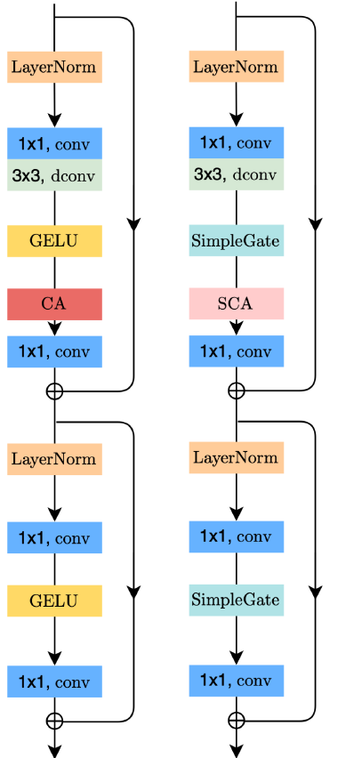
03
Method
(1/6)
NAFNet (Non Activation Function Net)
12

Slide 13
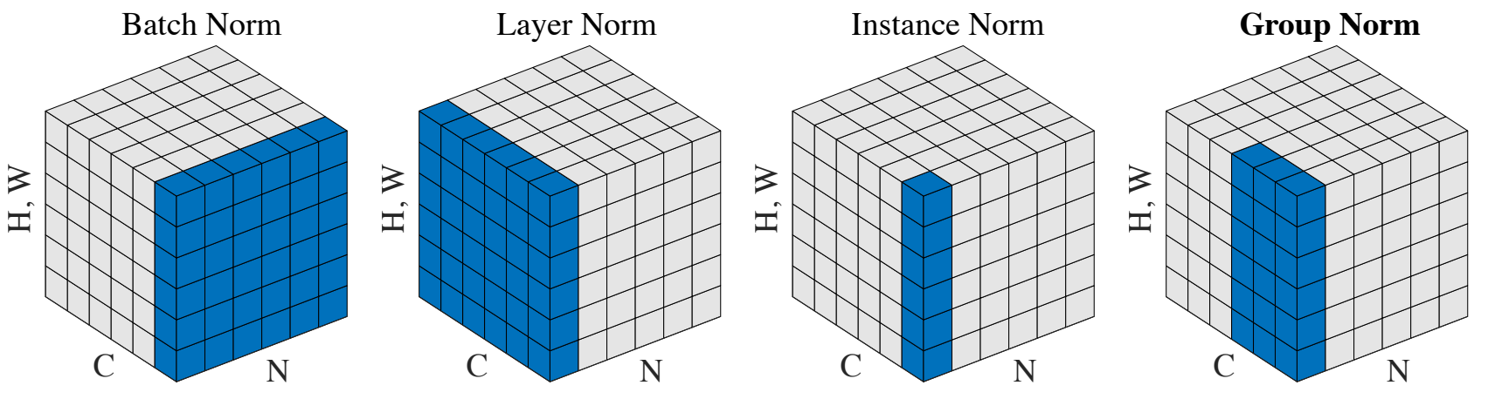
03
Method
(2/6)
Normalization (Batch, Layer, Instance)
N (batch)
C
H
W
13

Slide 14
03
Method
(3/6)
BN => IN => LN
BN: High-level vision task
IN: Style transformation
LN: Transformer
14

Slide 15
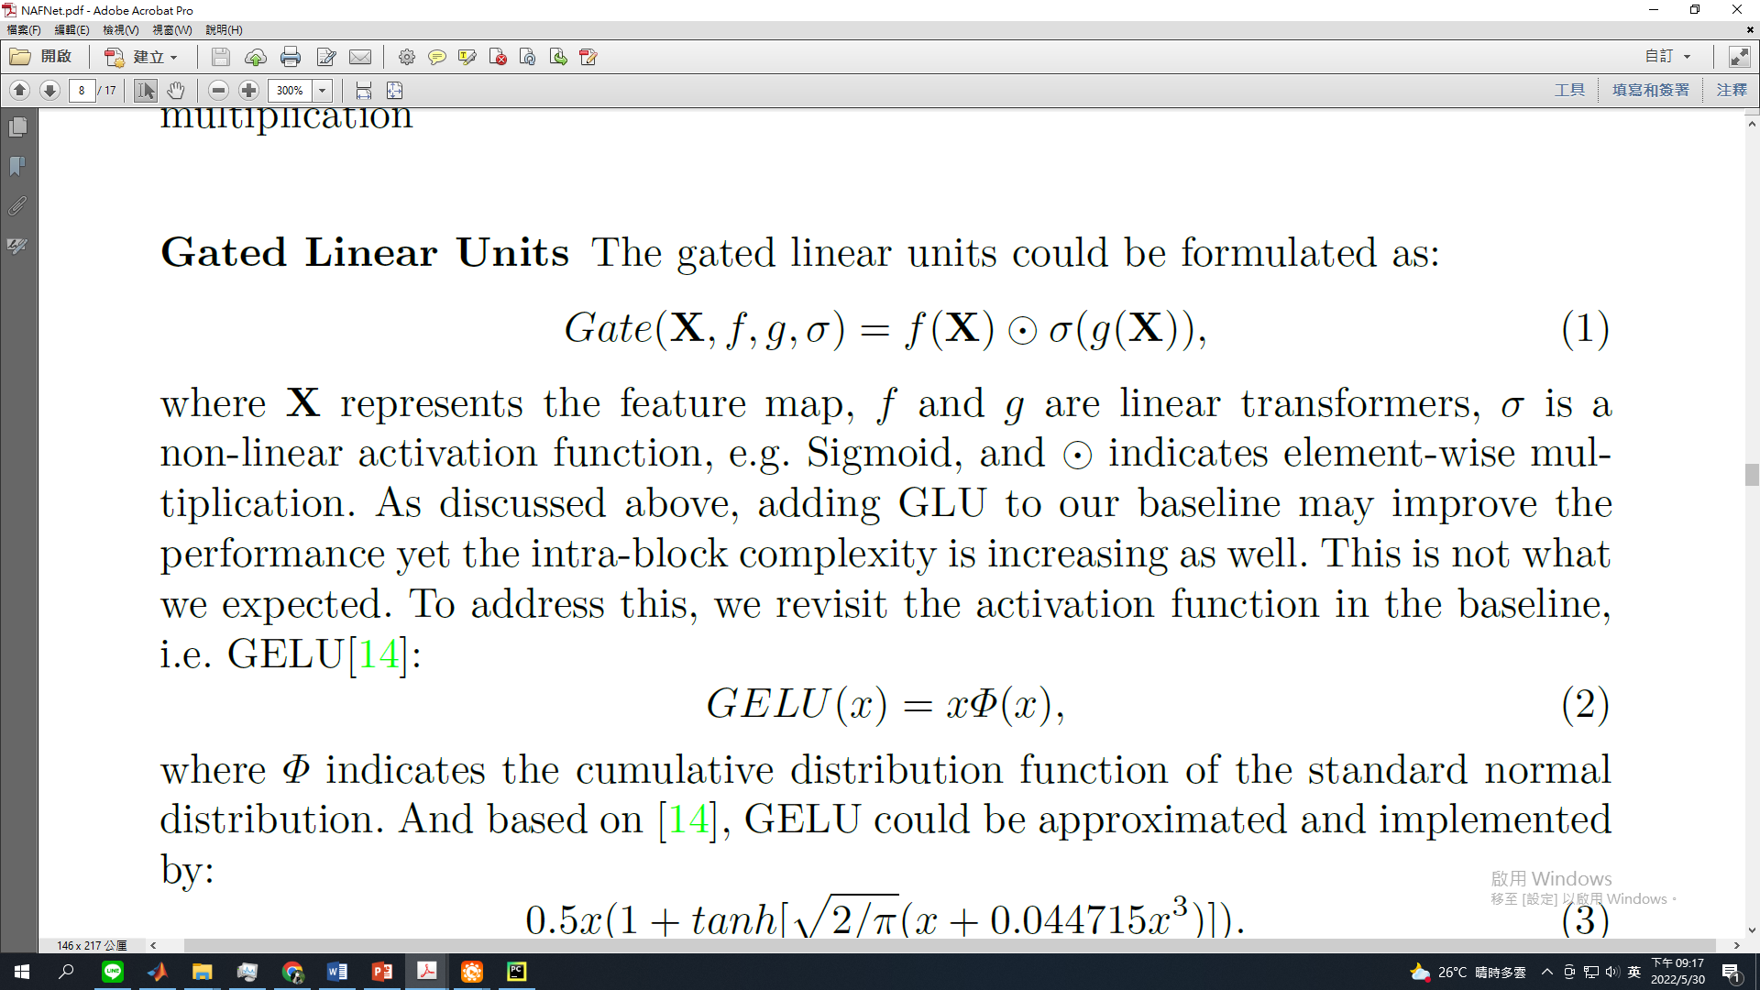
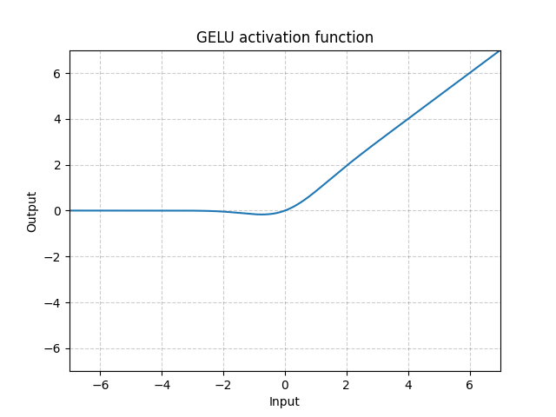
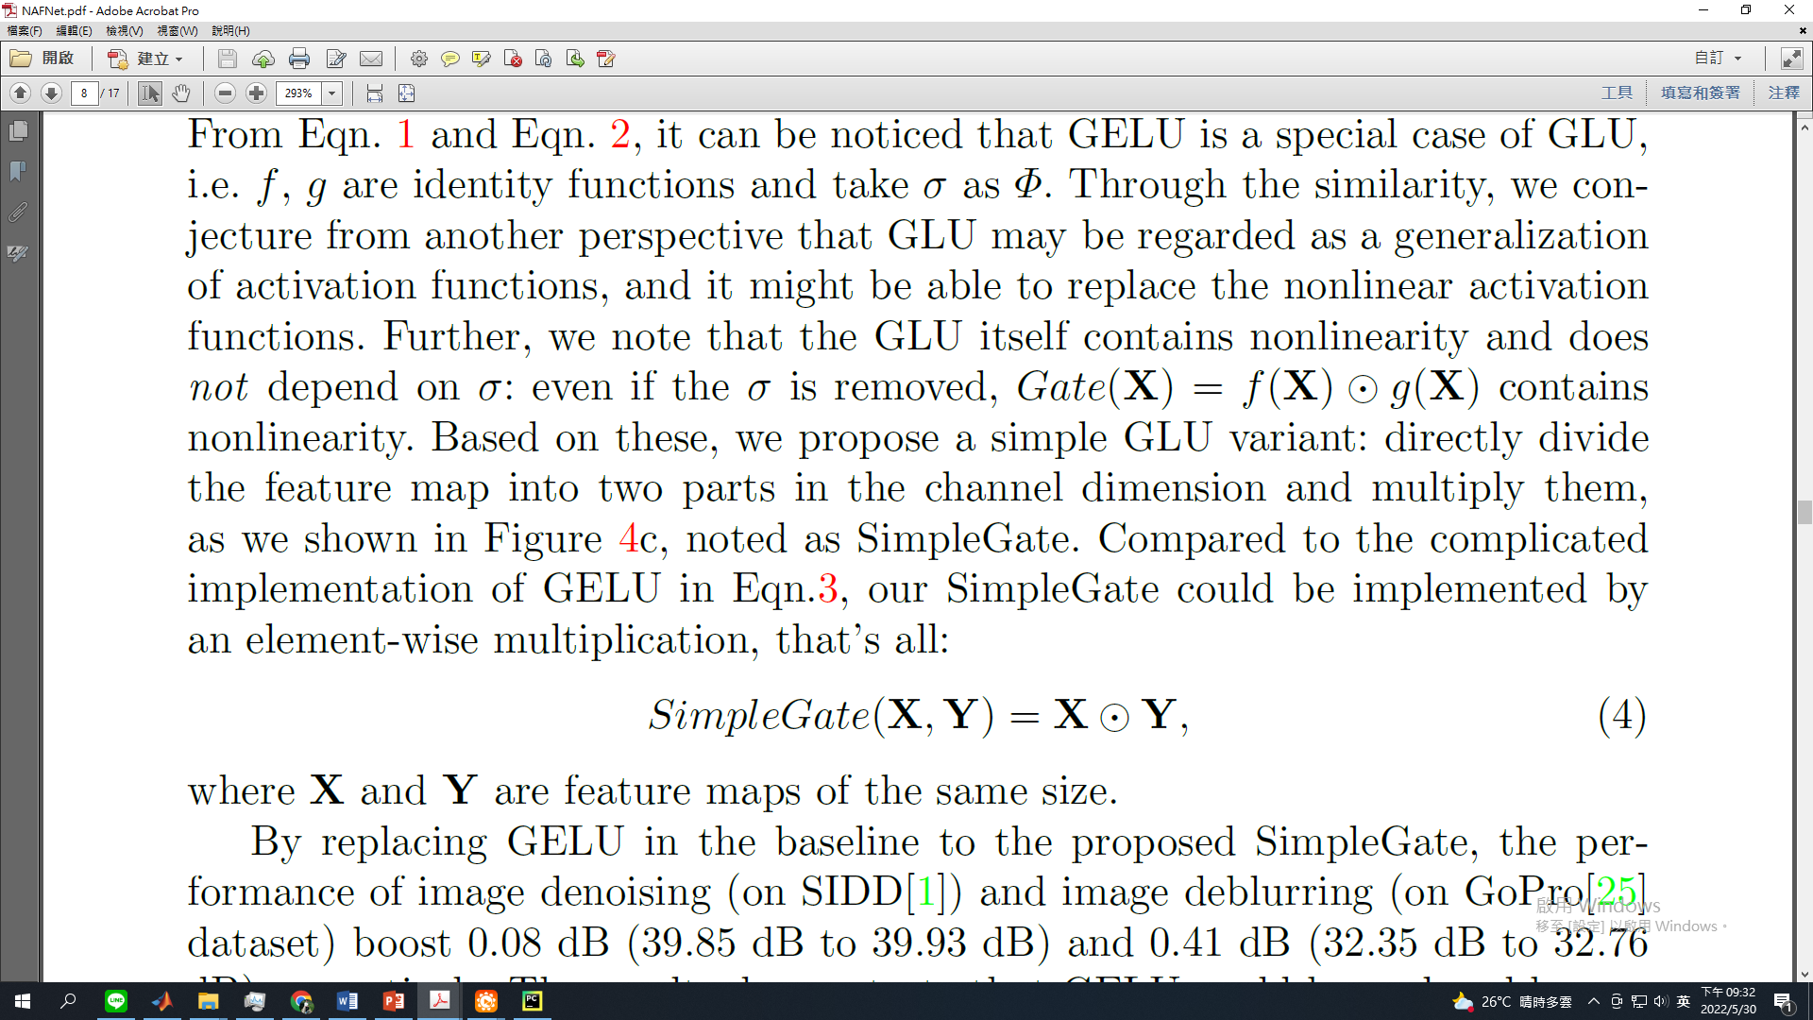
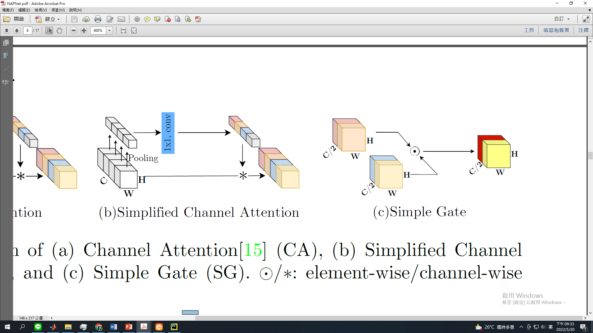
03
Method
(4/6)
SimpleGate
15
Notes:
GPT-3, BERT, and most other Transformers.

Slide 16
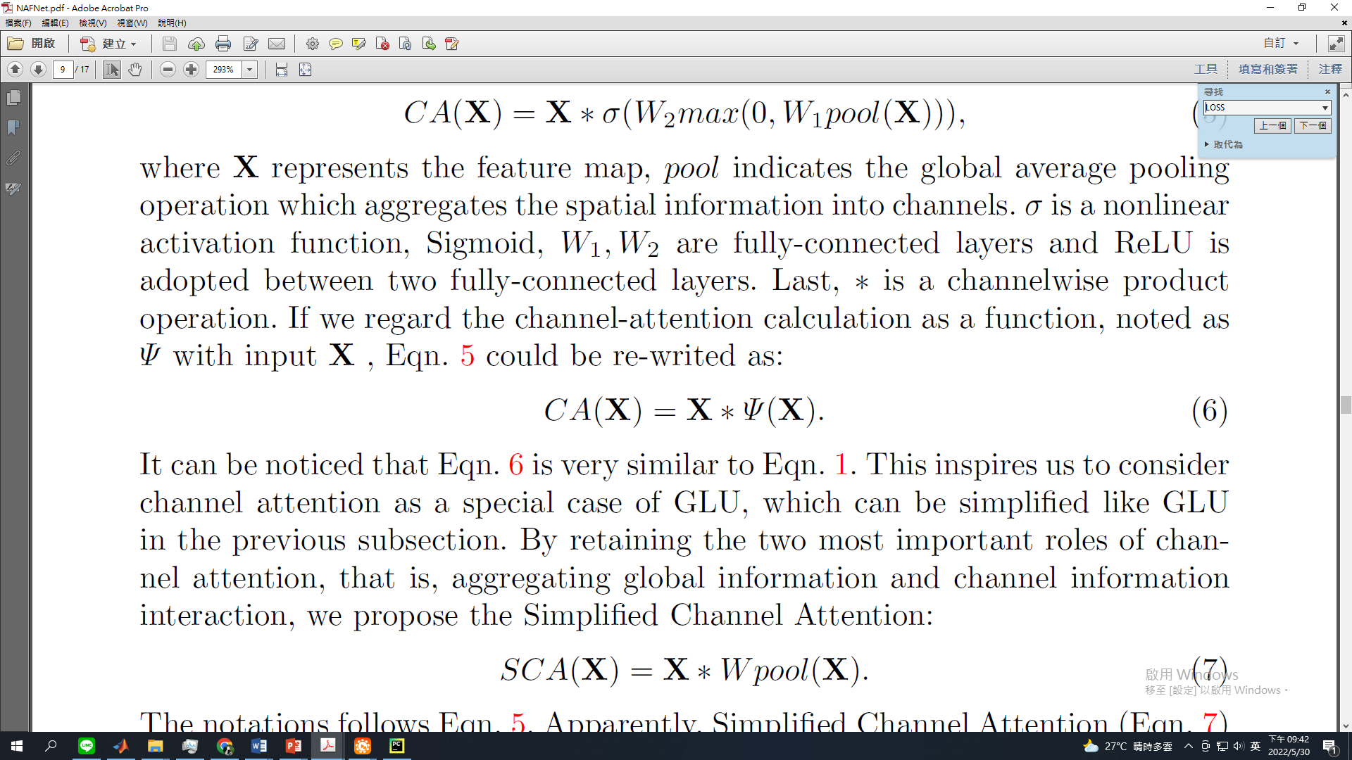
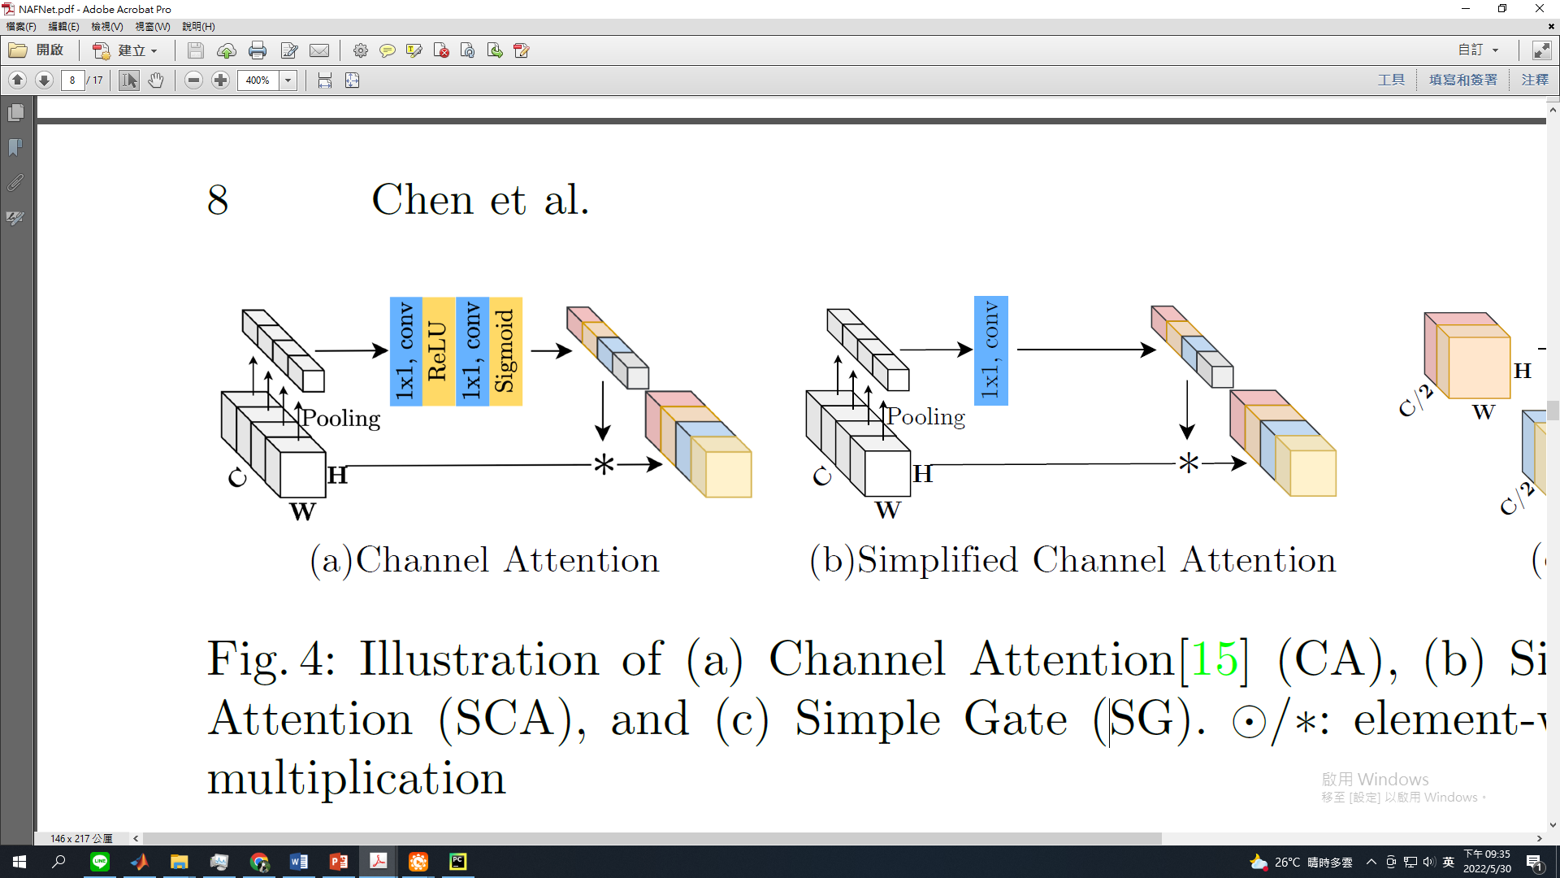
03
Method
(5/6)
Simplified Channel Attention (SCA)
16

Slide 17
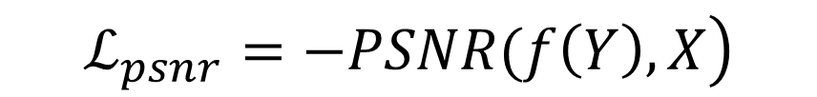
03
Method
(6/6)
Whole model & Loss function
5 level UNet with unbalanced NAFBlock design
Denoising:
{[2, 2, 4, 8], 12, [2, 2, 2, 2]}
Deblurring:
{[1, 1, 1, 28], 1, [1, 1, 1, 1]}
Loss function: PSNR loss
$$\left.ℒ_{psnr}=−PSNR(f\left(Y\right), X\right)$$
17
Notes:
E = 0.005
Lamda = 0.1

Slide 18
Outline
01
Introduction
02
Related Work
03
Method
04
Experiment
05
Conclusion

Slide 19
01
Introduction
02
Related Work
03
Method
04
Experiment
05
Conclusion

Slide 20
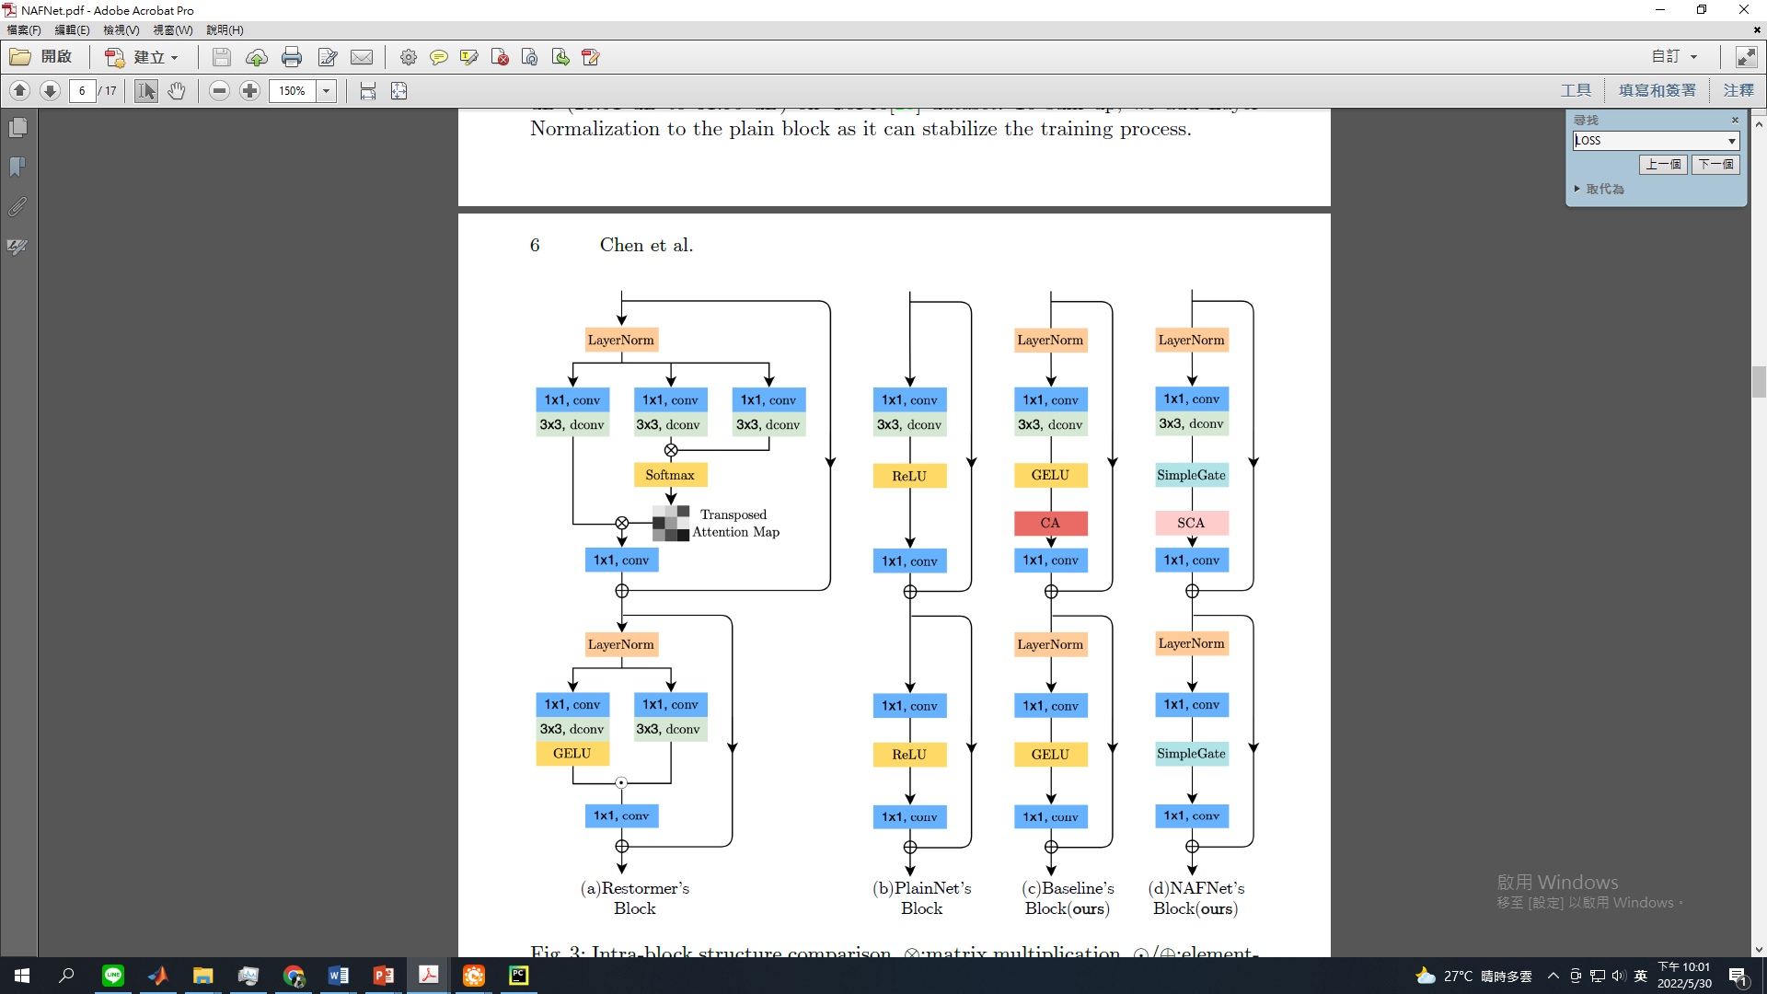
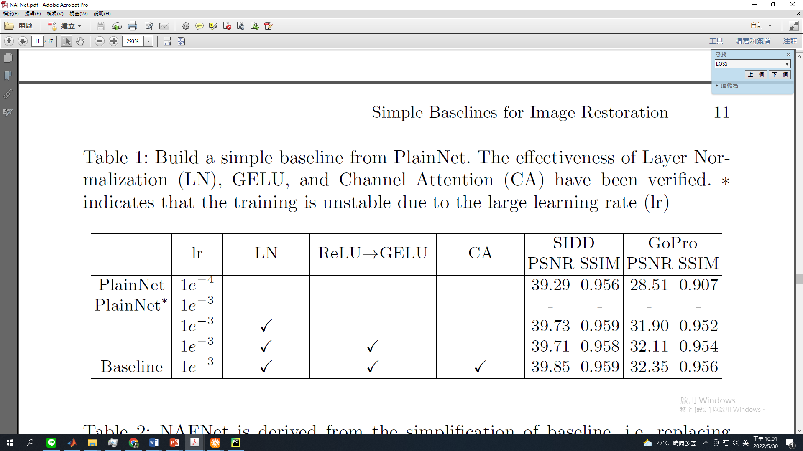
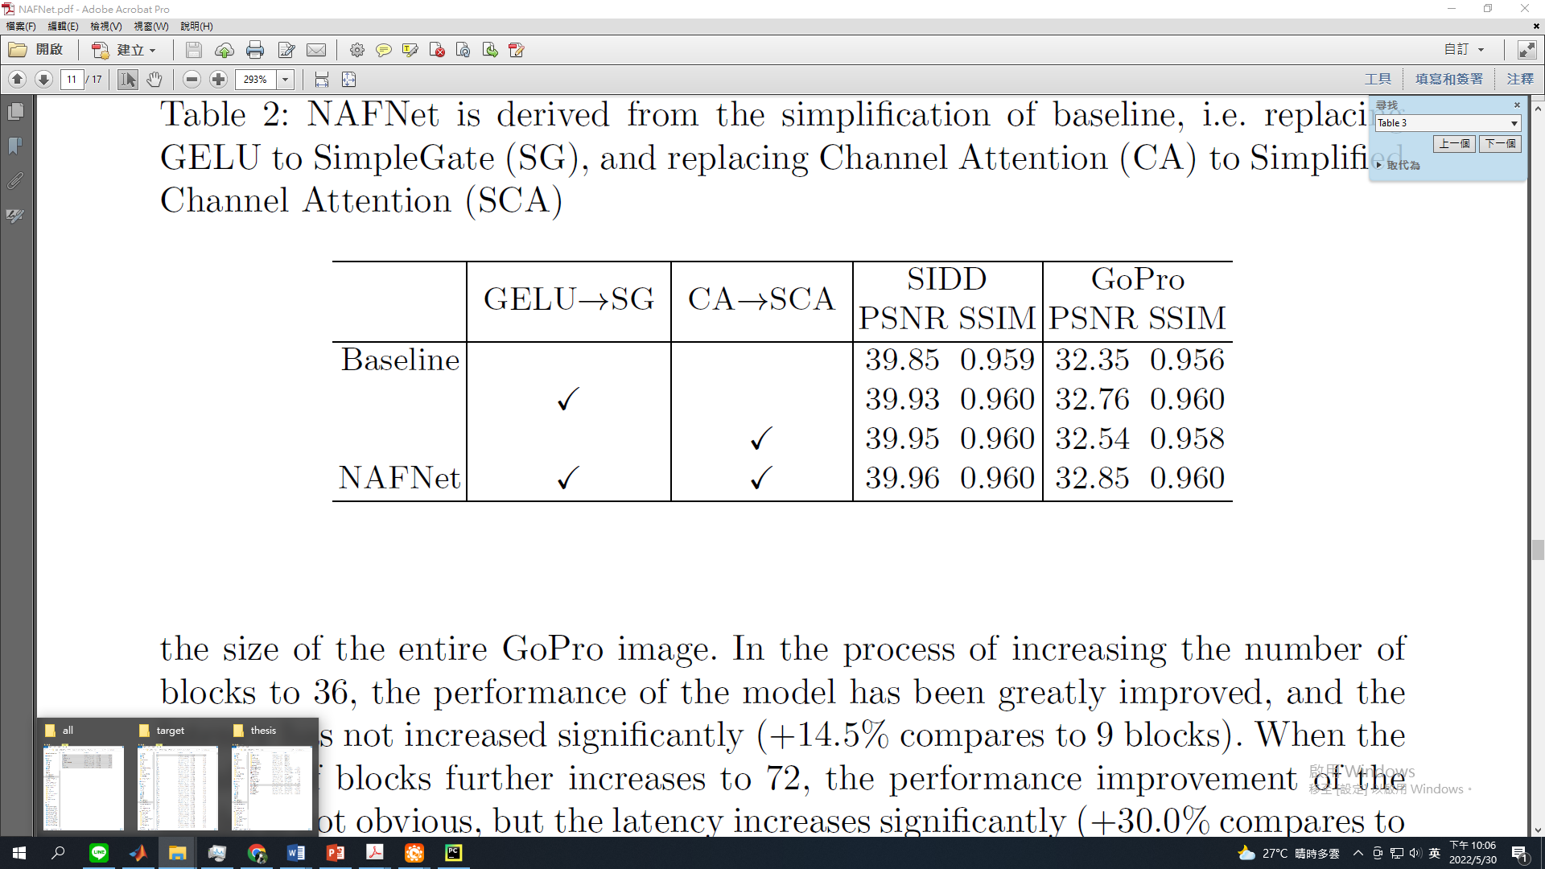
04
Experiment
(1/4)
Ablation Studies (1/2)
20

Slide 21
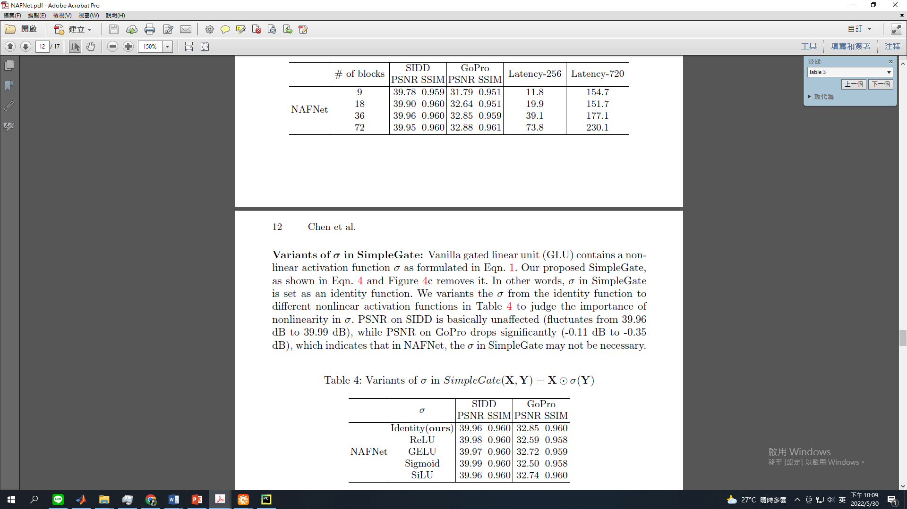
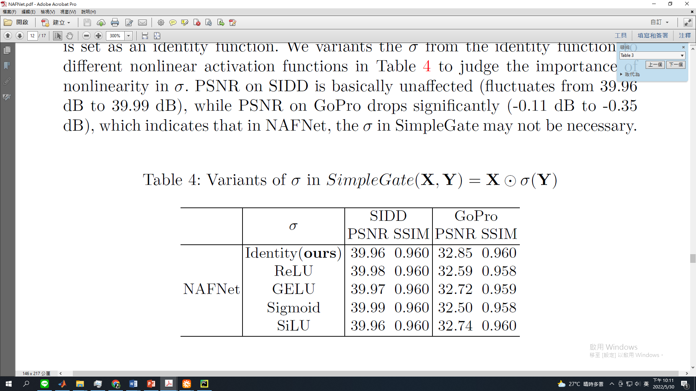
04
Experiment
(2/4)
Denoising: {[2, 2, 4, 8], 12, [2, 2, 2, 2]}
Deblurring: {[1, 1, 1, 28], 1, [1, 1, 1, 1]}
Ablation Studies (2/2)
21

Slide 22
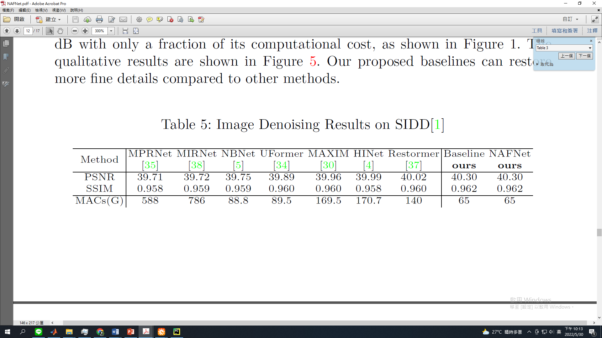
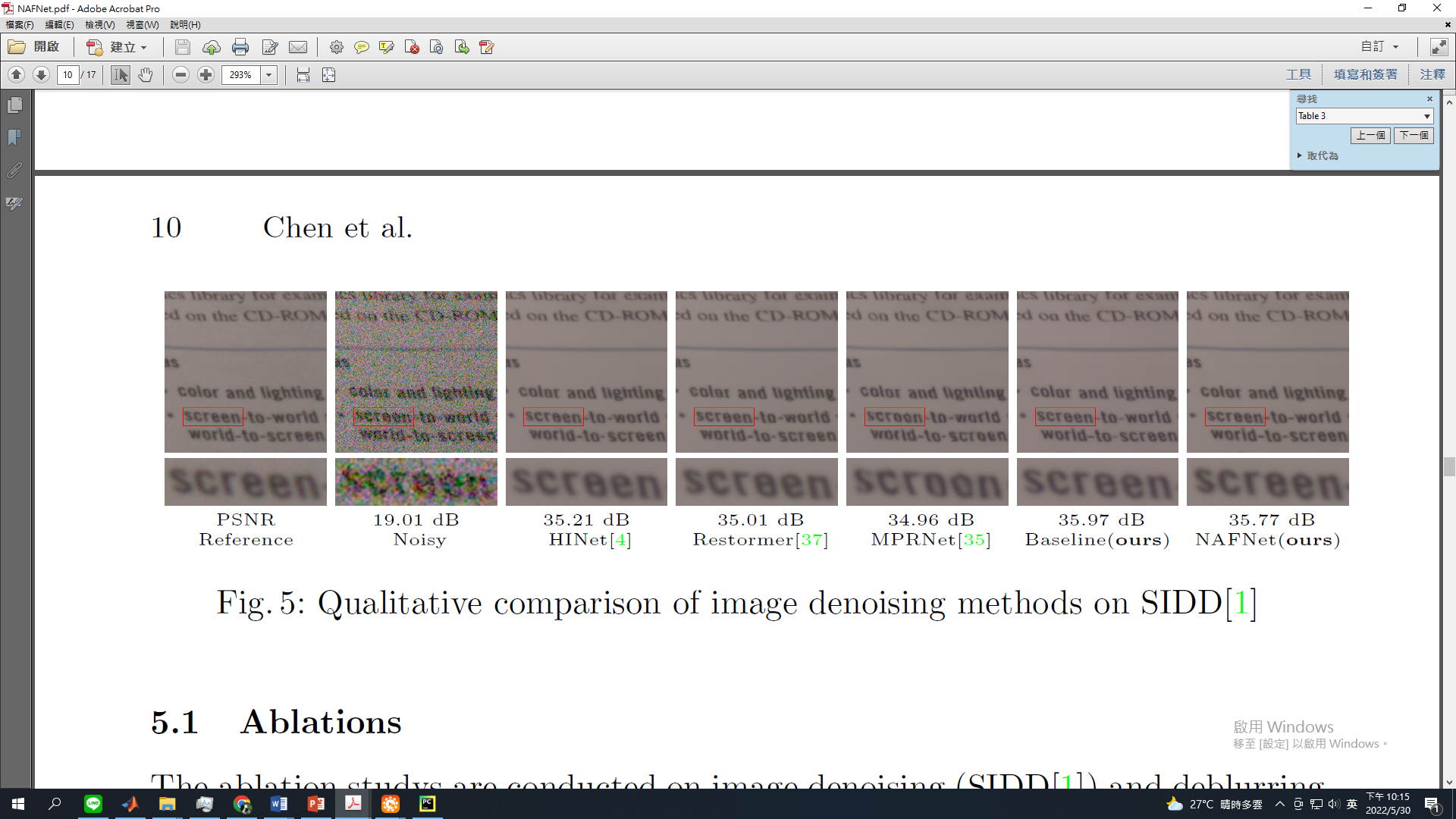
04
Experiment
(3/4)
Denoising results
22

Slide 23
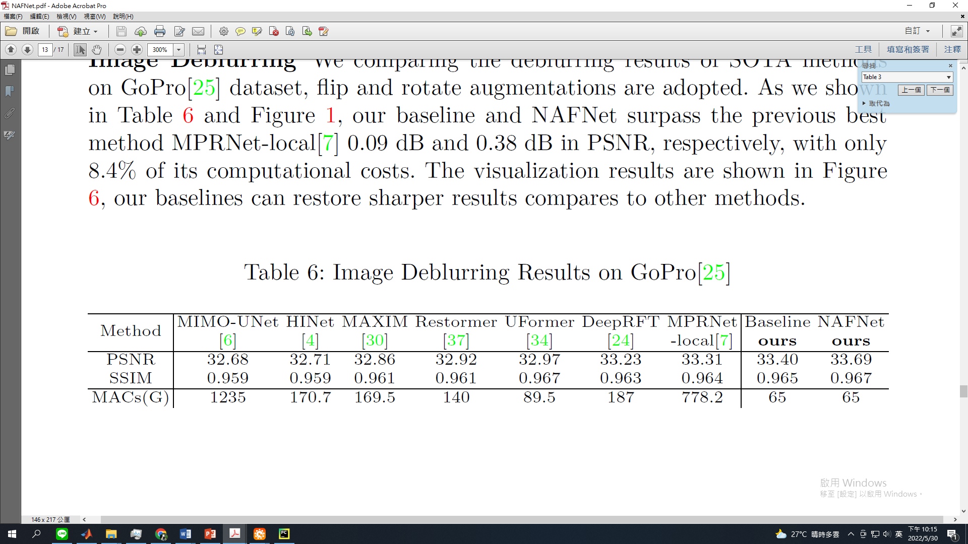
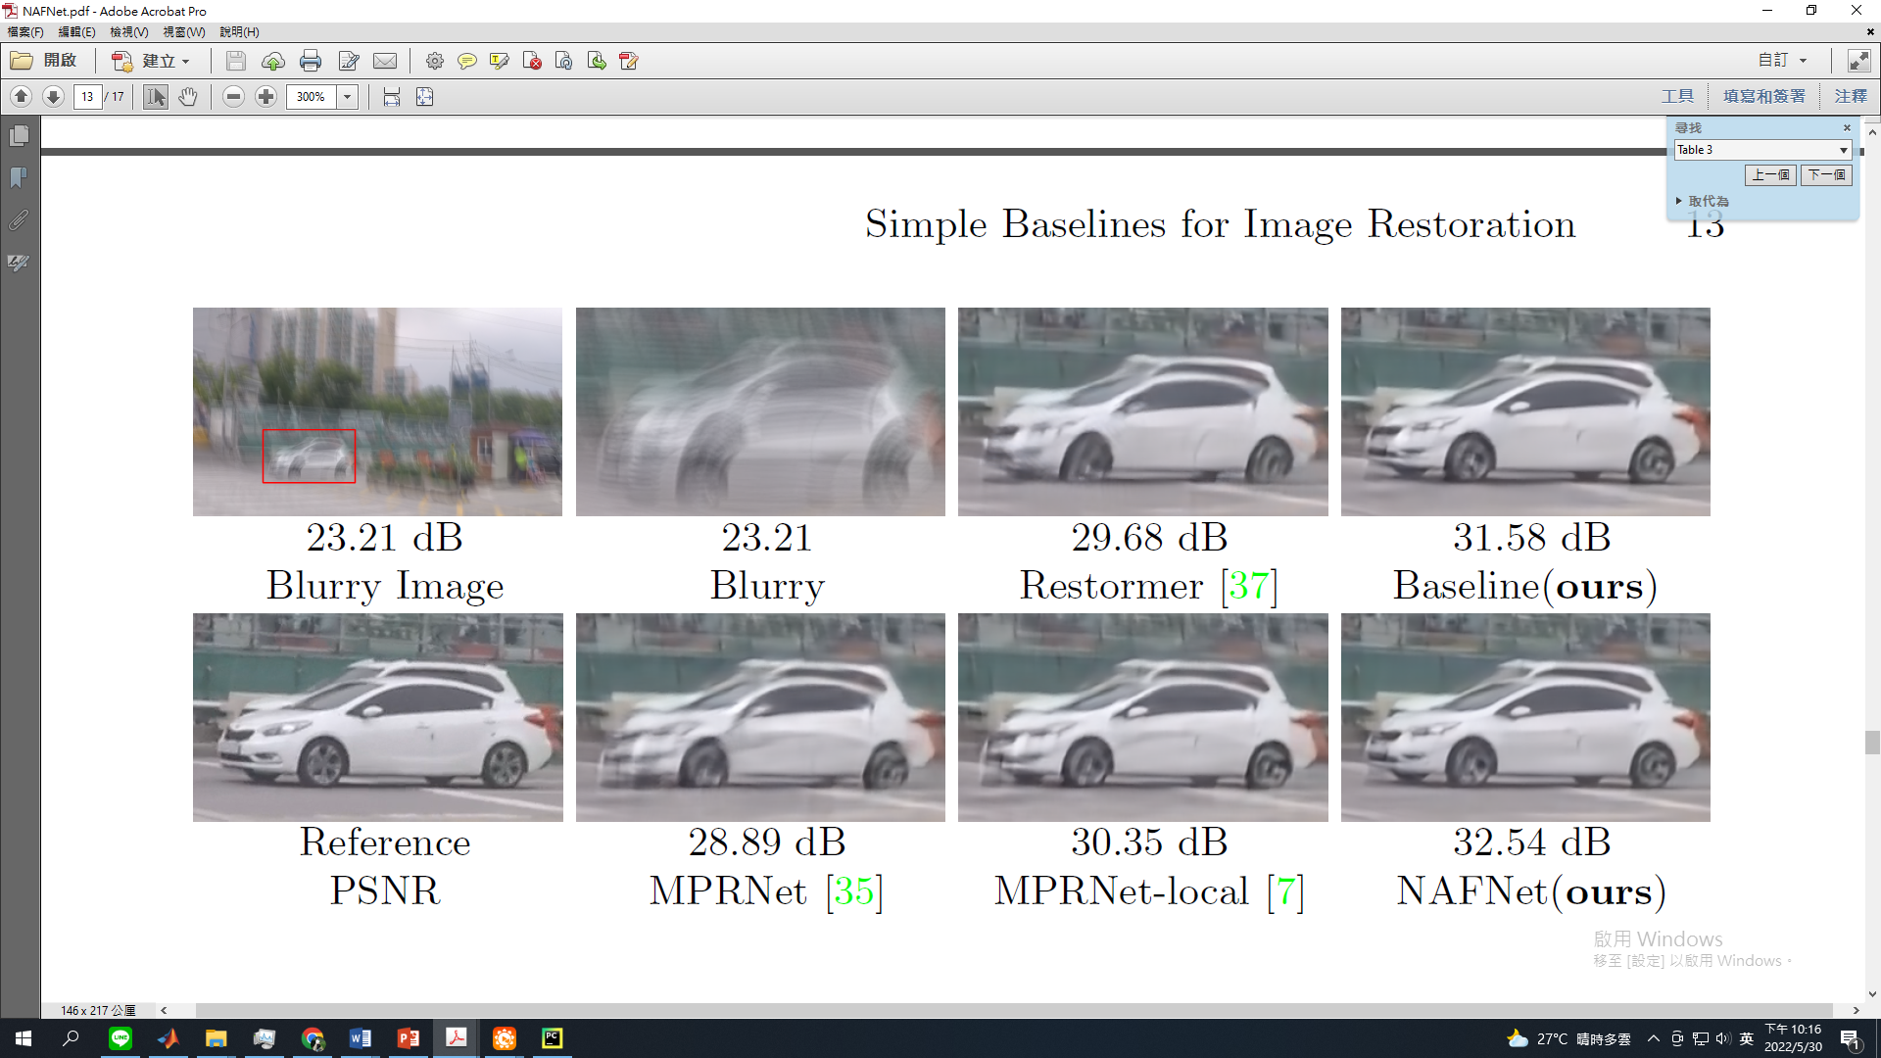
04
Experiment
(4/4)
Deblurring results
23

Slide 24
Outline
01
Introduction
02
Related Work
03
Method
04
Experiment
05
Conclusion

Slide 25
01
Introduction
02
Related Work
03
Method
04
Experiment
05
Conclusion

Slide 26
05
Conclusion
(1/2)
Conclusion
Proposed a nonlinear activation free network (NAFNet). With low complexity and model parameters but achieving the better or equal performances.
This work has the potential to influence future computer vision model design, as their demonstrate that nonlinear activation functions are not necessary to achieve SOTA performance.
26

Slide 27

05
Conclusion
(2/2)
Paper review
Some of multi-scale restoration models (MPRNet, HINet) are fixed the extracting block numbers in each layer. However, the state-of-the-art models (Restormer, NAFNet) are setting different block numbers in each layer. The number of blocks differently distribute in encoder, bottleneck and decoder which is deserve to discuss!
Is it the model without any activation has any side effect or any limitation? Maybe it can do further experiments to discuss.
27

Slide 28

Thanks for Listening
Student：Chi-Mao Fan
Date : 2022.06.01

